Slide 1


`
MODULE 5: Classification
Schulich School of Business MBAN 6110
Data Science I
Instructor: Boris Garbuzov
MBAN 6110
Fall 2020
SCHULICH SCHOOL OF BUSINESS | MBAN 6110
MODULE 1
Data Science I
2020

Slide 2
Discriminant Analysis
Here the approach is to model the distribution of X in each of the classes separately, and then use Bayes theorem to flip things around and obtain Pr(Y |X).
When we use normal (Gaussian) distributions for each class, this leads to linear or quadratic discriminant analysis.
However, this approach is quite general, and other distributions can be used as well. We will focus on normal distributions.

Slide 3
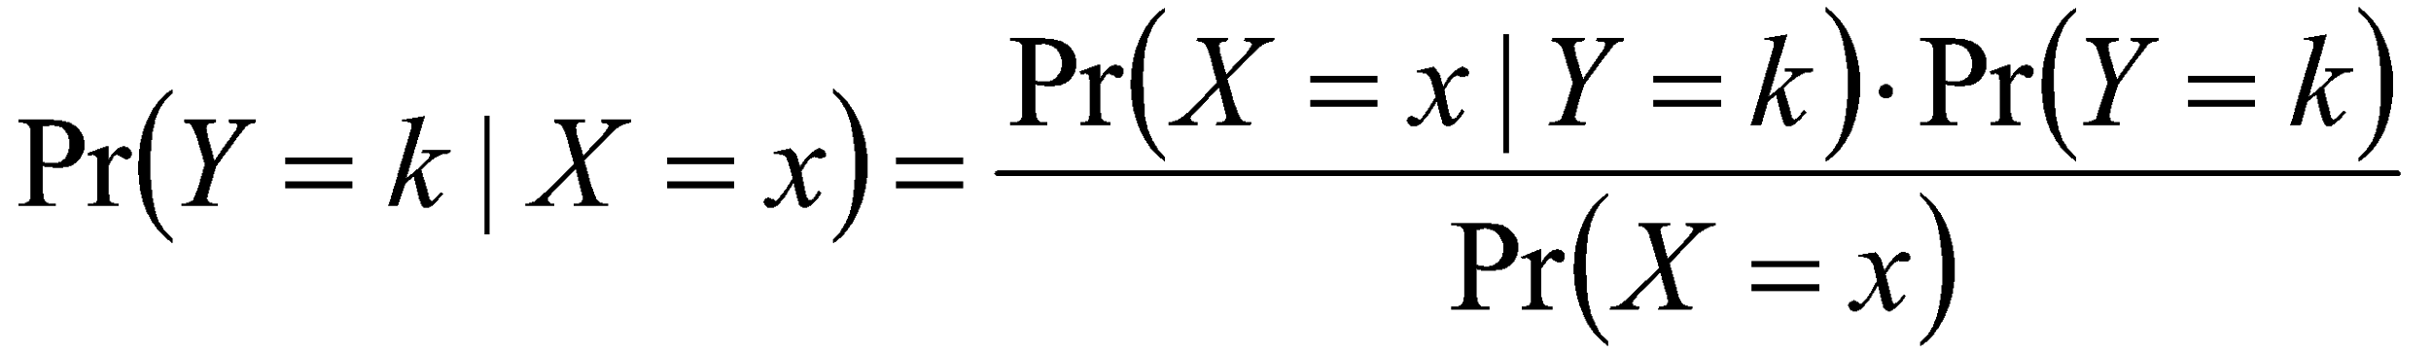
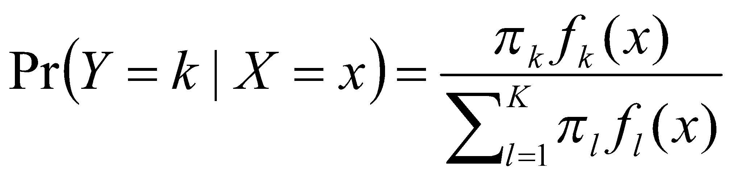
Bayes theorem for classification
Thomas Bayes was a famous mathematician whose name represents a big subfield of statistical and probabilistic modeling. Here we focus on a simple result, known as Bayes theorem:
One writes this slightly differently for discriminant analysis:
, where
f_{k} (x) = Pr(X = x|Y = k) is the density for X in class k. Here we will use normal densities for these, separately in each class.
π_{k} = Pr(Y = k) is the marginal or prior probability for class k.

Slide 4
Classify to the highest density
₁=.5, ₂=.5
₁=.3, ₂=.7
−4
−2
0
2
4
−4
−2
0
2
4
We classify a new point according to which density is highest.
When the priors are different, we take them into account as well, and compare π_{k}f_{k} (x). On the right, we favor the pink class — the decision boundary has shifted to the left.

Slide 5
Why discriminant analysis?
When the classes are well-separated, the parameter estimates for the logistic regression model are surprisingly unstable. Linear discriminant analysis does not suffer from this problem.
If n is small and the distribution of the predictors X is approximately normal in each of the classes, the linear discriminant model is again more stable than the logistic regression model.
Linear discriminant analysis is popular when we have more than two response classes, because it also provides
low-dimensional views of the data.

Slide 6
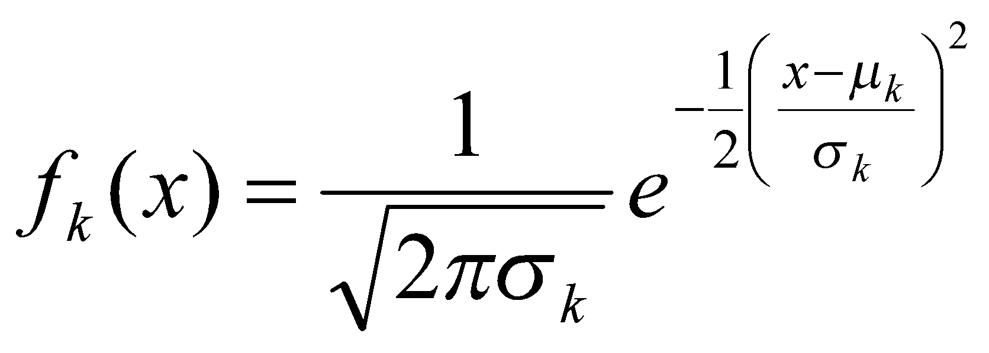
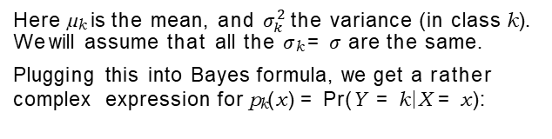
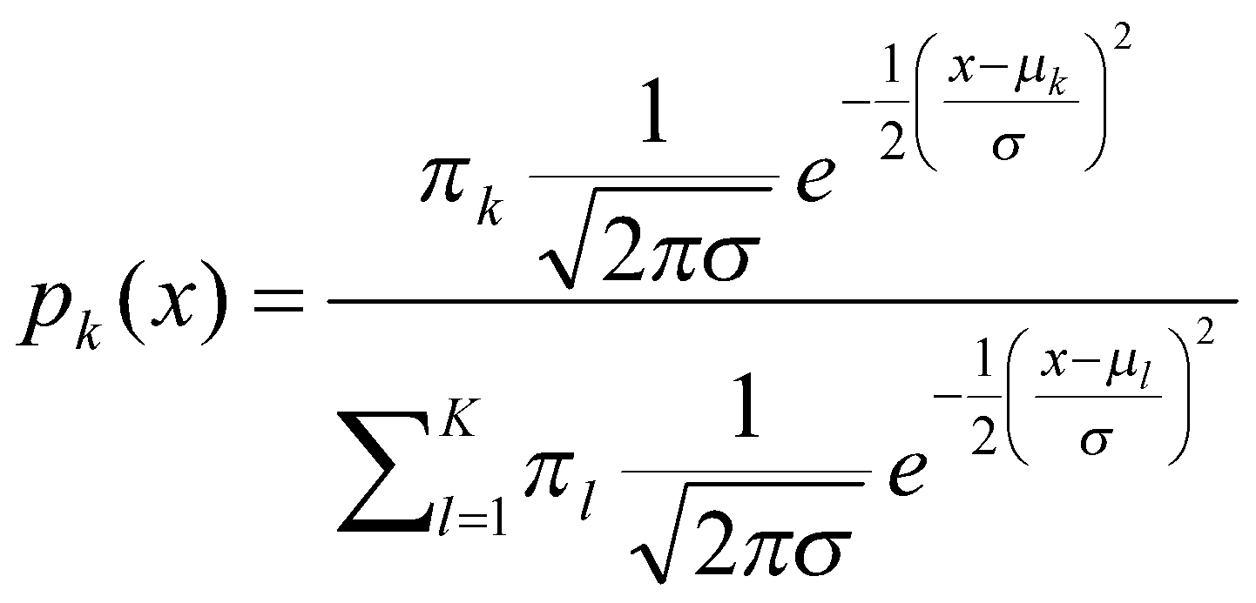
Linear Discriminant Analysis when p = 1
The Gaussian density has the form
Happily, there are simplifications and cancellations.

Slide 7
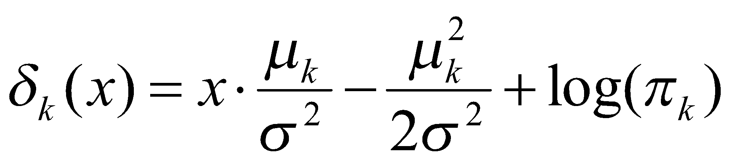

Discriminant functions
To classify at the value X = x, we need to see which of the p_{k} (x) is largest. Taking logs, and discarding terms that do not depend on k, we see that this is equivalent to assigning x to the class with the largest discriminant score:
Note that δ_{k} (x) is a linear function of x.
If there are K = 2 classes and π₁ = π₂ = 0.5, then one can see that the decision boundary is at
(See if you can show this)

Slide 8
5
4
3
2
1
0
−4
−2
0
2
4
−3 −2 −1 0
1
2
3
4
Example with µ₁ = −1.5, µ₂ = 1.5, π₁ = π₂ = 0.5, and σ² = 1.
Typically we d o n ’ t know these parameters; we just have the training data. In that case we simply estimate the parameters and plug them into the rule.

Slide 9
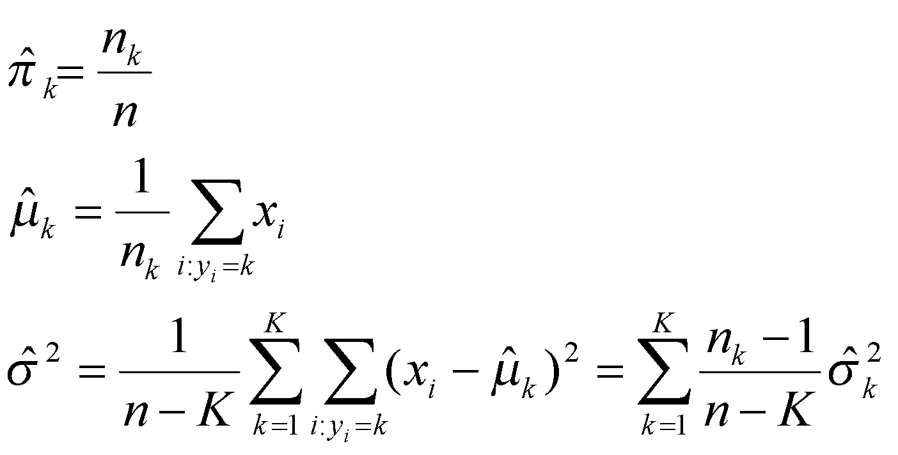
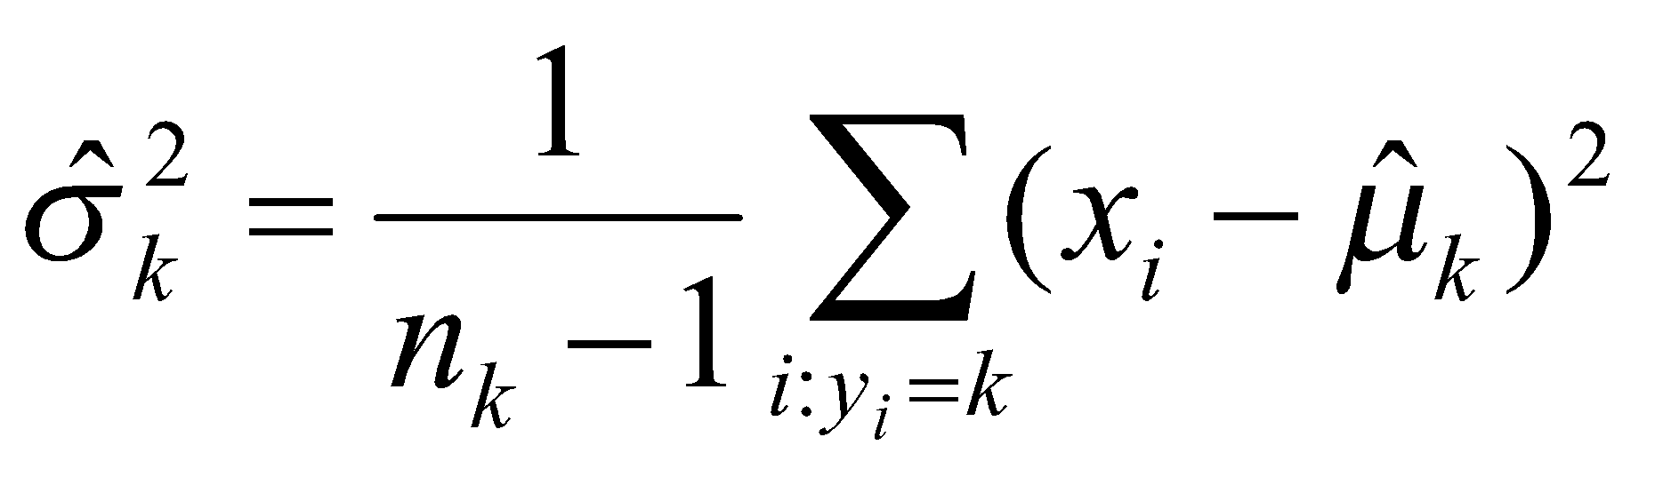
Estimating the parameters
where
is the usual formula for the
estimated variance in the kth class.

Slide 10
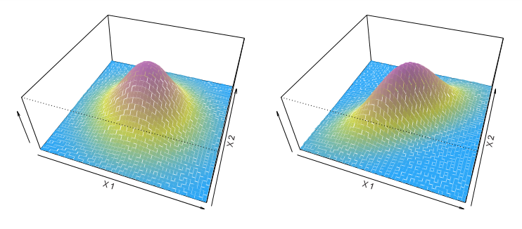
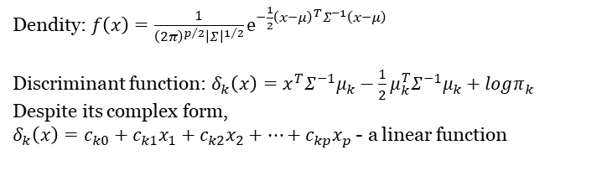
Linear Discriminant Analysis when p > 1

Slide 11
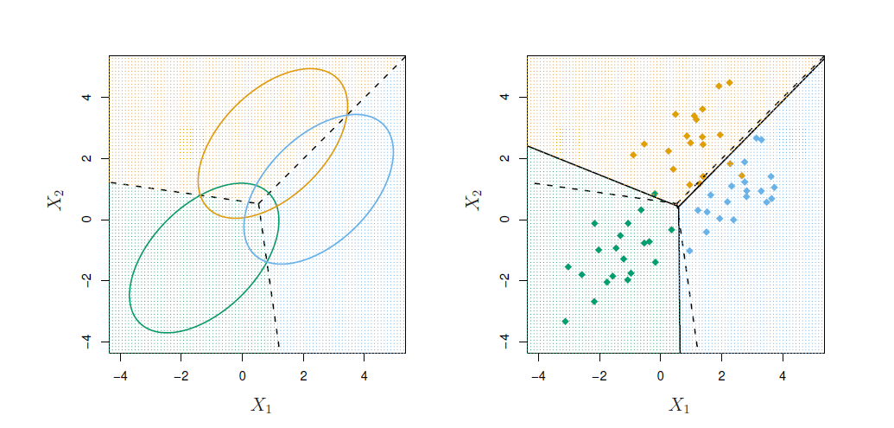
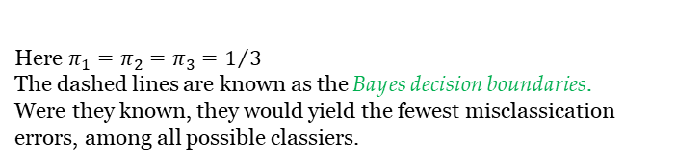
Illustration: p = 2 and K = 3 classes

Slide 12
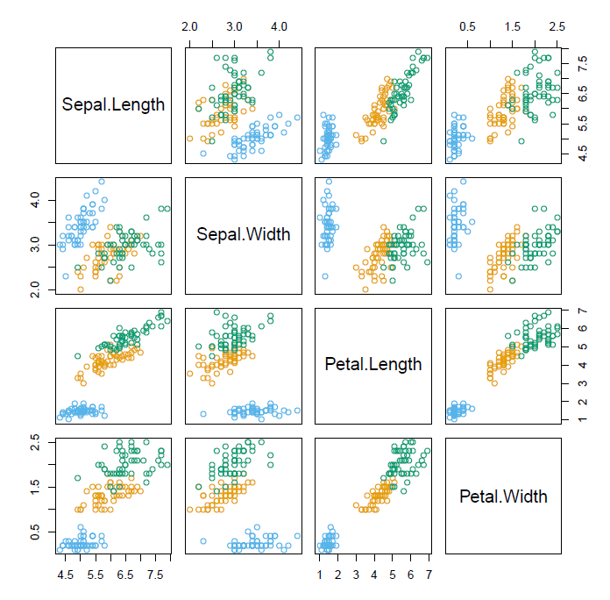
Fisher’s Iris Data
4 variables
3 species
50 samples/class
Setosa
Versicolor
Virginica
LDA classifies all but 3 of the 150 training samples correctly

Slide 13
Fisher’s Discriminant Plot
●
●
● ●●
● ●
●
●
● ●
●
● ● ●
●
● ●
●
● ●
● ●
●
●
● ●
● ●
●
● ● ●
●●●●● ●
●● ●
● ●
●
● ●
● ● ●
●
Discriminant Variable 2
●●●●
●
●
● ●
●
●
●
−2 −1 0 1 2
●●●
●● ● ●●
●●●
●●●●
●● ●●
● ● ●
●
●● ●●
● ● ●
●●
●●
●●●●●● ● ●●
● ●●●
●
●
●
●●
●
●
●
●
●
●
●
● ●
● ●●
● ●
●
●
●
●
●
● ● ●
●●
●
●
●
● ●
●
−10
−5
0
5
10
Discriminant Variable 1
When there are K classes, linear discriminant analysis can be viewed exactly in a K − 1 dimensional plot.
Why? Because it essentially classifies to the closest centroid, and they span a K − 1 dimensional plane.
Even when K > 3, we can find the “ b e s t ” 2-dimensional plane for visualizing the discriminant rule.

Slide 14
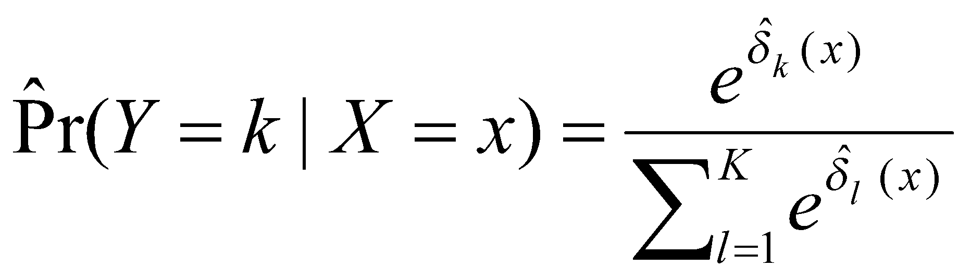


From δ_{k}(x) to probabilities
Once we have estimates δ^{ˆ}_{k} (x), we can turn these into estimates for class probabilities:
So classifying to the largest δ^{ˆ}_{k} (x) amounts to classifying to the class for which (Y =k|X =x) is largest.
When K = 2, we classify to class 2 if
(Y = 2|X = x) ≥ 0.5, else to class 1.

Slide 15
LDA on Credit Data
 |  | True Default Status
 |  | No | Yes | Total
Predicted | No | 9644 | 252 | 9896
Default Status | Yes | 23 | 81 | 104
 | Total | 9667 | 333 | 10000
(23 + 252)/10000 errors — a 2.75% misclassification rate! Some caveats:
This is training error, and we may be overfitting. Not a big concern here since n = 10000 and p = 2!
If we classified to the prior — always to class No in this case — we would make 333/10000 errors, or only 3.33%.
Of the true N o ’ s , we make 23/9667 = 0.2% errors; of the true Y e s ’ s , we make 252/333 = 75.7% errors!

Slide 16
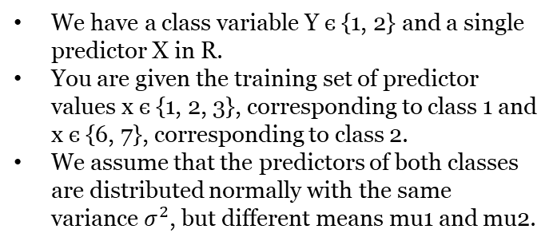

LDA. Problem settings

Slide 17
LDA quiz question 1
What is the number n₁ of class 1 points in the training sample?
1
2
3
4

Slide 18
LDA quiz question 2
What is the number n₂ of class 2 points in the training sample?
1
2
3
4

Slide 19
LDA quiz question 3
What is the total number n of points in the training sample?
3
4
5
6

Slide 20
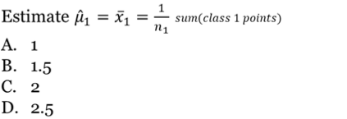
LDA quiz question 4

Slide 21
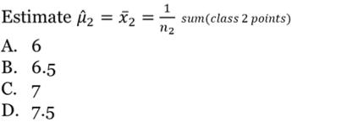
LDA quiz question 5

Slide 22
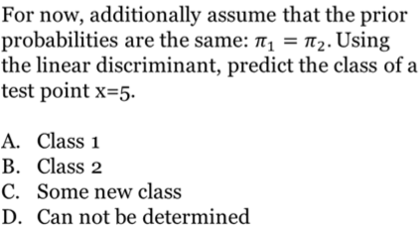
LDA quiz question 6

Slide 23
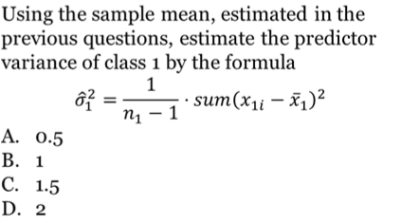
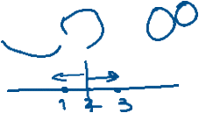
LDA quiz question 7

Slide 24
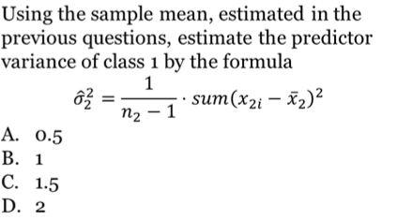
LDA quiz question 8

Slide 25
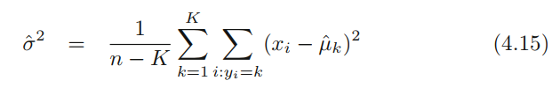
LDA quiz question 9
Using the textbook formula
to estimate the overall variance.
0.4
0.8
1.2
1.6

Slide 26
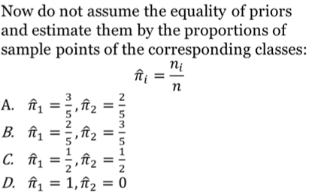
LDA quiz question 10

Slide 27
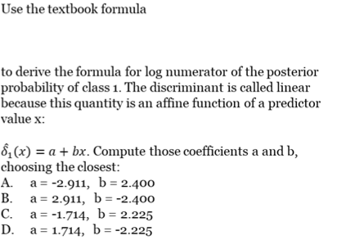

LDA quiz question 11

Slide 28

LDA quiz question 12

Slide 29
LDA quiz question 13
Using your results in the previous questions, compute the log numerator of the posterior probability of class 1 for the predictor value x=5. Choose the closest:
6.089
7.089
8.089
9.089

Slide 30
LDA quiz question 14
Using your results in the previous questions, compute the log numerator of the posterior probability of class 2 for the predictor value x=5. Choose the closest:
10.739
11.739
12.739
13.739

Slide 31
LDA quiz question 15
Based on the earlier estimated log numerators of the posterior probabilities, estimate the class of the same point x=5:
Class 1
Class 2
Some new class
Can not be determined

Slide 32
LDA & QDA questions
Which module contains …
LDA class
sklearn.discriminant_analysis.LinearDiscriminantAnalysis
sklearn.linear_models.LinearDiscriminantAnalysis
sklearn.linear_models.discriminant_analysis.LDA
sklearn.discriminant_analysis.LDA
2. QDA class
sklearn.discriminant_analysis.QuadraticDiscriminantAnalysis
sklearn.linear_models.QuadraticDiscriminantAnalysis
sklearn.linear_models.discriminant_analysis.QDA
sklearn.discriminant_analysis.QDA

Slide 33
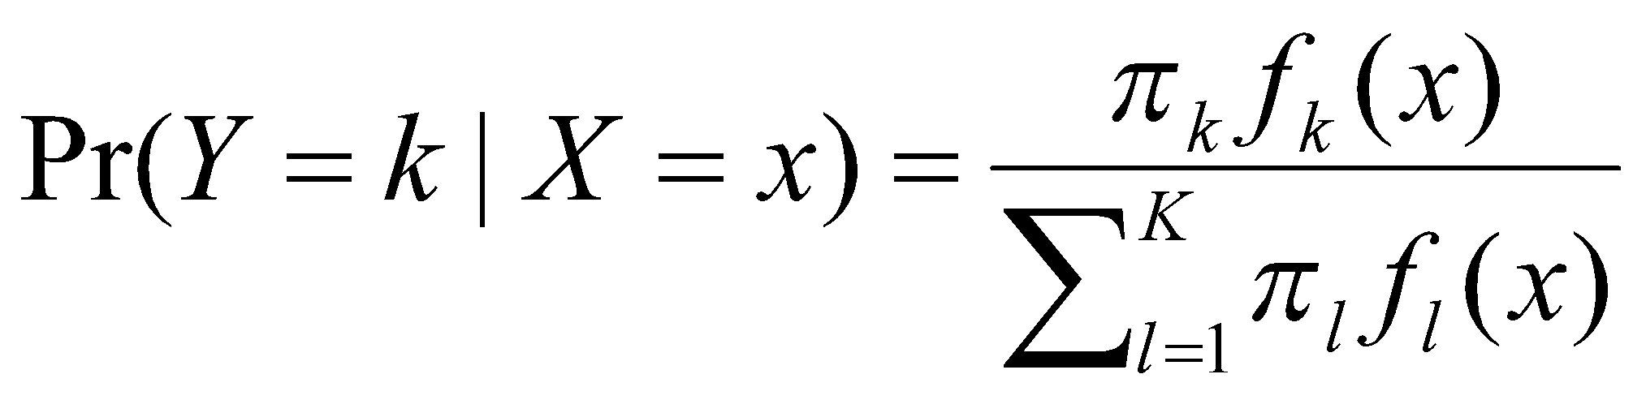
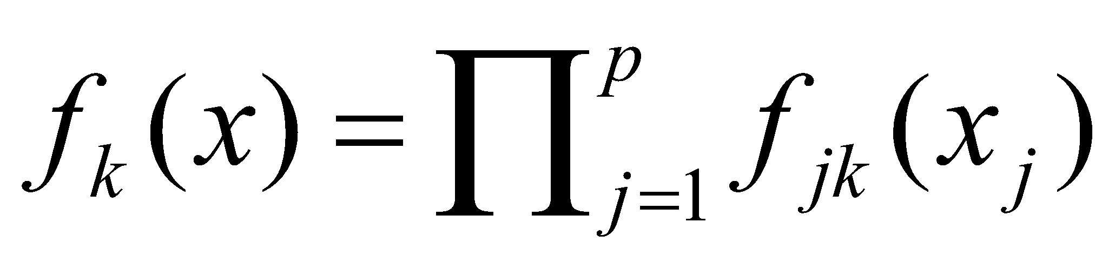
Other forms of Discriminant Analysis
When f_{k} (x) are Gaussian densities, with the same covariance matrix Σ in each class, this leads to linear discriminant analysis. By altering the forms for f_{k} (x), we get different classifiers.
With Gaussians but different Σ_{k} in each class, we get quadratic discriminant analysis.
With
(conditional independence
model) in each class we get naive Bayes. For Gaussian this means the Σ_{k} are diagonal.
Many other forms, by proposing specific density models for f_{k} (x), including nonparametric approaches.

Slide 34
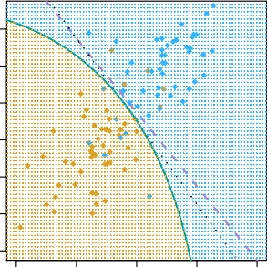
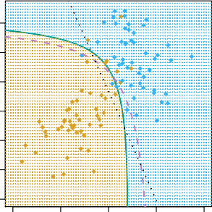
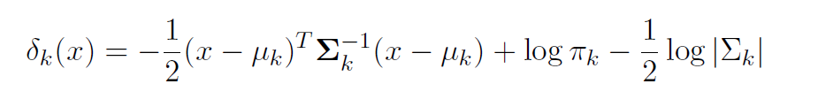
Quadratic Discriminant Analysis
2
1
X₂
−1 0
X₂
−4 −3 −2 −1 0 1 2
−2
−3
−4
−4 | −2 | 0 | 2 | 4 | −4 | −2 | 0 | 2 | 4
 |  | X₁ |  |  |  |  | X₁
Because the Σ_{k} are different, the quadratic terms matter.

Slide 35
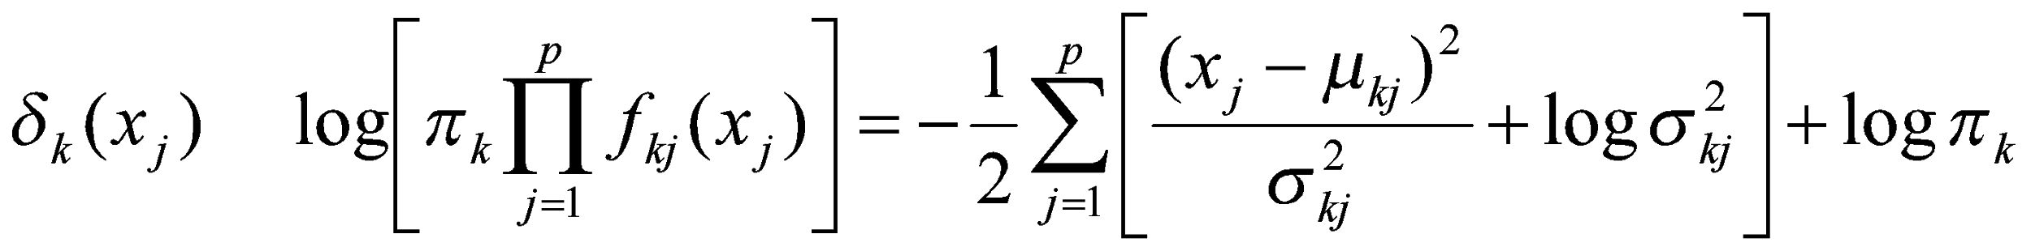
Naive Bayes
Assumes features are independent in each class.
Useful when p is large, and so multivariate methods like QDA and even LDA break down.
Gaussian naive Bayes assumes each Σ_{k} is diagonal:
can use for mixed feature vectors (qualitative and quantitative). If X_{j} is qualitative, replace f_{kj} (x_{j} ) with probability mass function (histogram) over discrete categories.
Despite strong assumptions, naive Bayes often produces good classification results.

Slide 36
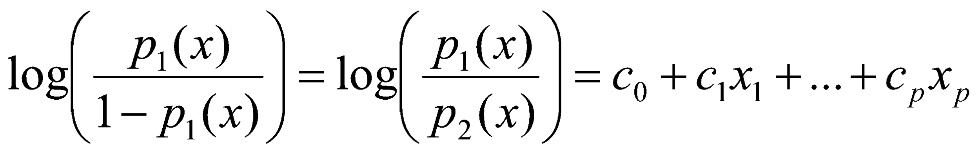
Logistic Regression versus LDA
For a two-class problem, one can show that for LDA
So it has the same form as logistic regression.
The difference is in how the parameters are estimated.
Logistic regression uses the conditional likelihood based on Pr(Y |X) (known as discriminative learning).
LDA uses the full likelihood based on Pr(X, Y ) (known as
generative learning).
Despite these differences, in practice the results are often very similar.
Footnote: logistic regression can also fit quadratic boundaries like QDA, by explicitly including quadratic terms in the model.

Slide 37
Summary
Logistic regression is very popular for classification, especially when K = 2.
LDA is useful when n is small, or the classes are well separated, and Gaussian assumptions are reasonable. Also when K > 2.
Naive Bayes is useful when p is very large.
See Section 4.5 for some comparisons of logistic regression, LDA and KNN.

